Slide 1
Johns Hopkins Health System Banking & Treasury Management ~ Journey of a Claim ~
November 14, 2017
Presented by:
Presented: by
11/13/2017
Dave Amann, Director, Banking Services – Johns Hopkins Health System

Slide 2
Journey of a Claim
Provider
Clearing
House
Payer
Clearing
House
Front
Desk
Billing Office
Insurer
Patient Experience @ TOS
Provider
Clearing
House
Payer
Clearing
House
Patient Receives EOB
Provider’s Bank
Billing Office
11/13/2017
11/13/2017

Slide 3
Patient Experience at Time of Service
Patient insurance verification
Acceptance of co-pay via cash, check, credit card, flex spending card
11/13/2017
11/13/2017

Slide 4
Provider’s (Doctor’s) Front Desk Administration
Reports encounter to the Provider’s (Doctor’s) Billing Office
Patient payments received at time of service (TOS) are deposited by visiting banking center, armored car, remote deposit (image cash letter) and credit card
Credit card intake
Provider maintains relationship with Merchant Processor and Gateway Provider if needed
Equipment – multiple selections possible such as –
single processing unit
internet based (software as a service)
card readers - chip or magnetic
integrated payment and AR posting like EPIC
11/13/2017
11/13/2017

Slide 5
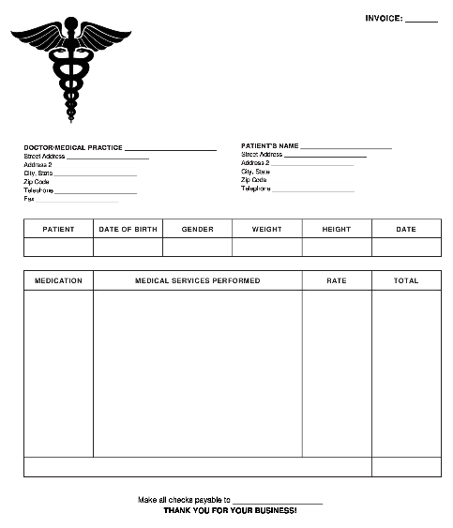
Provider’s Billing Office
Encounter including procedure information received by Provider’s Billing Office
Invoice created using standard coding and submitted to the Provider’s Clearing House electronically using standard 837 file format or other comparable format
11/13/2017
11/13/2017

Slide 6
Provider’s Clearing House
Claim invoice information received and reviewed / reformatted to ensure compliance with 837 file format
Invoice details submitted to the Insurer’s (Payer’s) Clearing House
11/13/2017
11/13/2017

Slide 7
Payer’s Clearing House
Claim invoice information received and reviewed / reformatted to enable the Insurer’s payment processing software to consume the data
11/13/2017
11/13/2017

Slide 8
Insurer
Reviews member plan / coverage information
Reviews claims using specific criteria and adjudicates according to member’s plan fee schedule
Insurer runs payment cycle
Insurer sends payment detail to its (Payer) Clearing House
11/13/2017
11/13/2017

Slide 9
Journey of a Claim – Round-Trip!
11/13/2017
11/13/2017

Slide 10
Payer’s - Clearing House
Insurer sends remittance information in 835 file format to Clearing House for distribution
Clearing House distributes 835 file format remittance information
Clearing House banking partner delivers payments via paper check, ACH / EFT or VCC (virtual credit card)
11/13/2017
11/13/2017

Slide 11
Provider’s Clearing House and Bank
Provider’s Clearing House receives remittance information in 835 file format
reformats to allow provider’s billing office receivable system to consume file details and post receipts
Provider’s bank receives payments via paper check, ACH / EFT or VCC (virtual credit card)
11/13/2017
11/13/2017

Slide 12
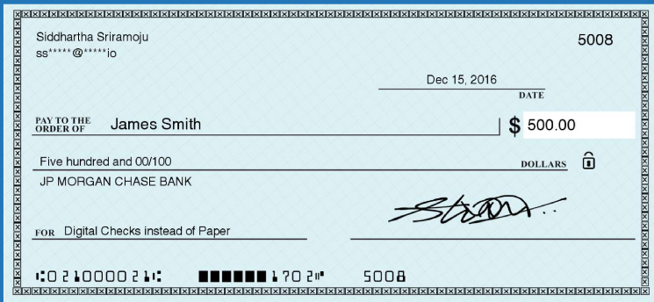
Provider’s Billing Office
Provider’s Billing Officer receives reformatted payment details for posting to patient accounts
Provider may receive payment via paper check, ACH / EFT or VCC
Handling cost …
EFT – low cost
VCC - relatively high
Paper checks – costly & cumbersome
11/13/2017
11/13/2017

Slide 13
Provider’s Billing Office - Continued
Provider’s Billing Office MUST register with Payer’s Clearing House to receive electronic payment (EFT) or VCC
Without registration, payment defaults to paper check
Provider MUST also register with Payer’s Clearing House to receive electronic remittance 835 file (claims detail)
11/13/2017
11/13/2017

Slide 14
Provider’s Bank
Lockbox Service - If Provider elects to receive payment via paper check, it may be mailed to a lockbox
Lockbox services include -
imaging of checks and remittances
creation of manufactured 835 files using optical character recognition (OCR)
OCR processes digitalize images
Bank will deliver manufactured 835 files to Provider’s Clearing House or directly to Provider
11/13/2017
11/13/2017

Slide 15
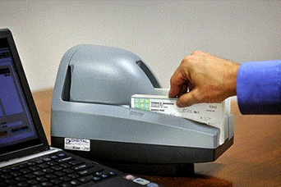
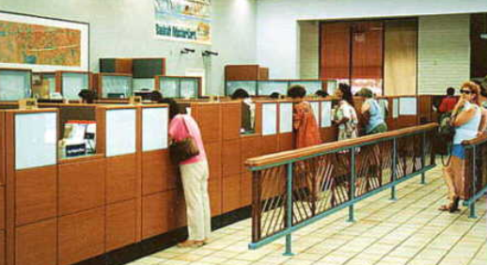
Provider’s Bank Continued
Alternate Check Deposit Options -
Remote Deposit – checks received in regular mail may be deposited through Remote deposit scanners
Banking Center – checks may also be hand delivered to banking center for deposit
Bank Cash Vault – checks can be picked by armored car and delivered to the bank’s cash vault for processing
11/13/2017
11/13/2017

Slide 16
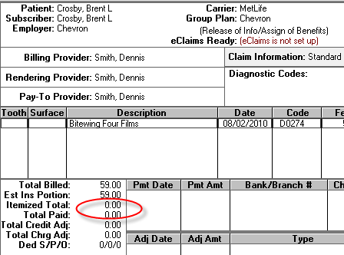
End of the Journey
Patients receive Explanation of Benefits (EOB) in the mail or electronically at their home
EOB’s outline services, costs and coverage
Many Provider offices encourage patients to visit a secure website to obtain this information and more
11/13/2017
11/13/2017

Slide 17
Questions ??????
11/13/2017
11/13/2017

