Slide 1
Money Market Portals, Workflow Efficiency & Investment Alternatives

Slide 2
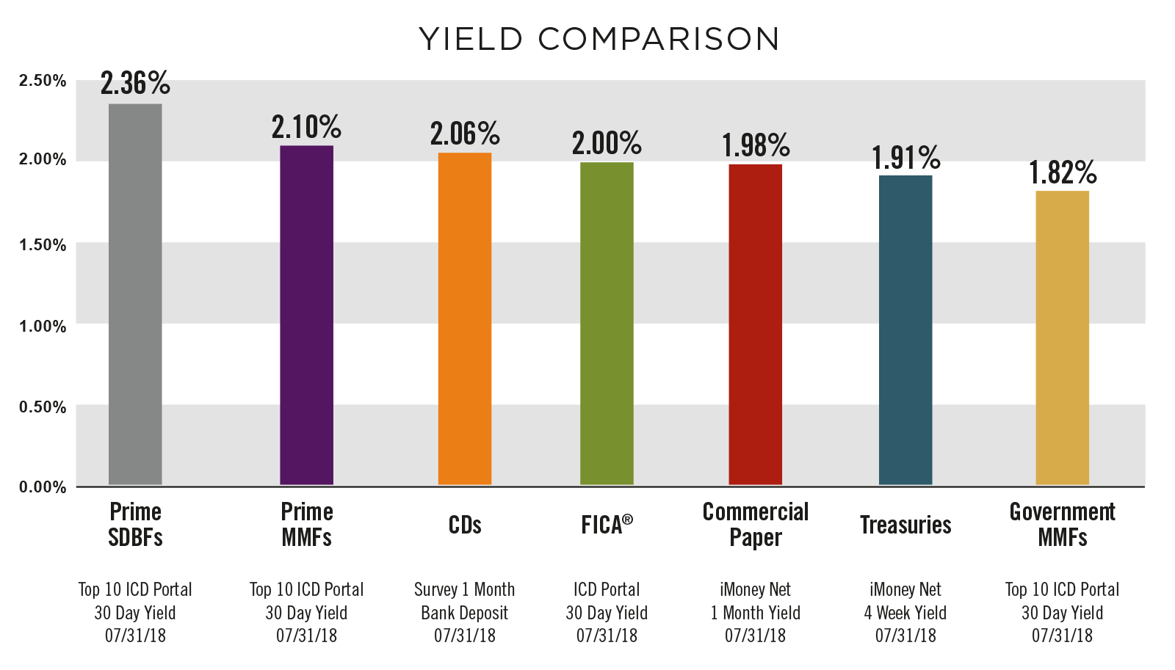
Institutional Investment Options – Yield Comparisons

Slide 3
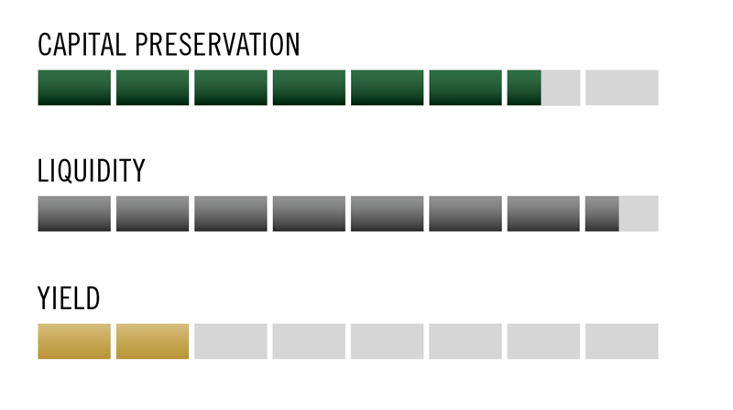
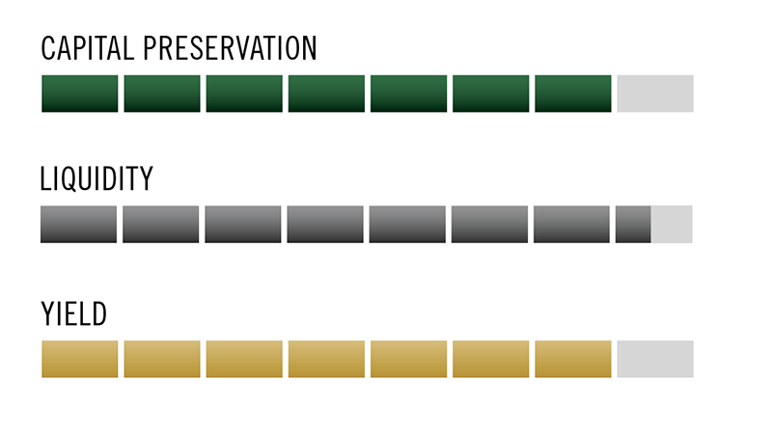
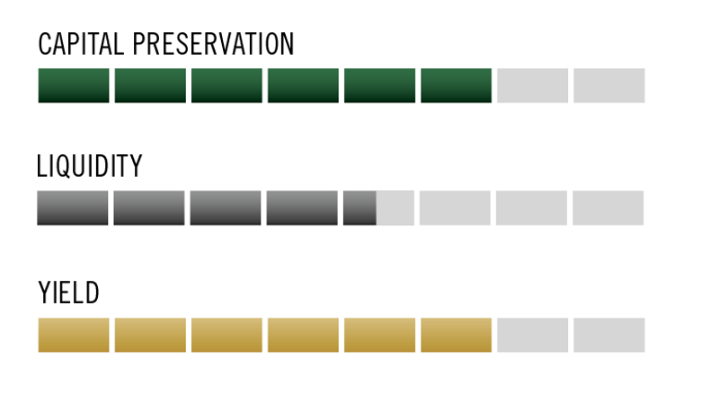
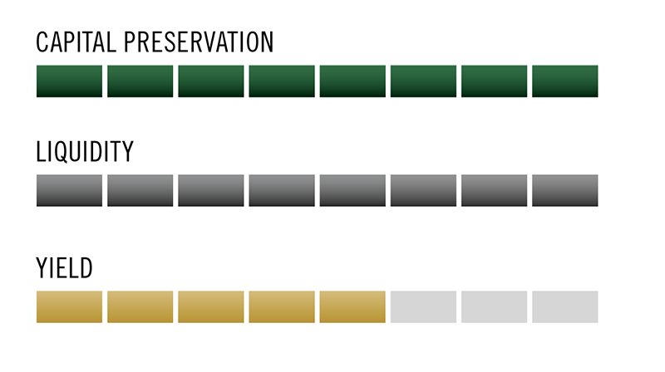
Institutional Investment Options – Investment Objectives
BANK DEPOSITS
Capital Preservation is good, however with single-credit exposure and over 500 bank failures since 2008, there is some principal risk.
Liquidity is high, except in the event of counterparty failure.
Yield (ECR) is low.
PRIME INSTITUTIONAL MMFs
Capital Preservation is very good based on diversification, a 40+ year MMF history and low volatility of NAV.
Liquidity (same day) is high.
Yield is high.
TERM BANK DEPOSITS
Capital Preservation is good, but like Overnight Deposits there is some principal risk due to the single-credit nature of the exposure.
Liquidity is limited due to fixed term. Penalties/fees may be incurred for early withdrawals.
Yield is moderate to high, depending on term.
GOVERNMENT INSTITUTIONAL MMFs
Capital Preservation is excellent as securities are backed by the United States Government and/or Government Agencies and NAV is stable.
Liquidity (same day) is high.
Yield is generally low to moderate for a government-backed investment.

Slide 4
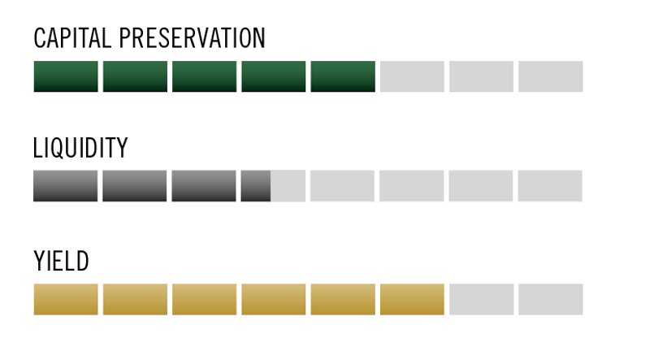
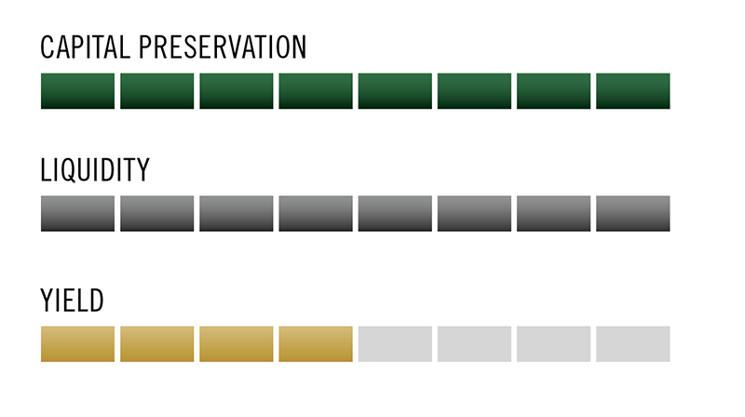
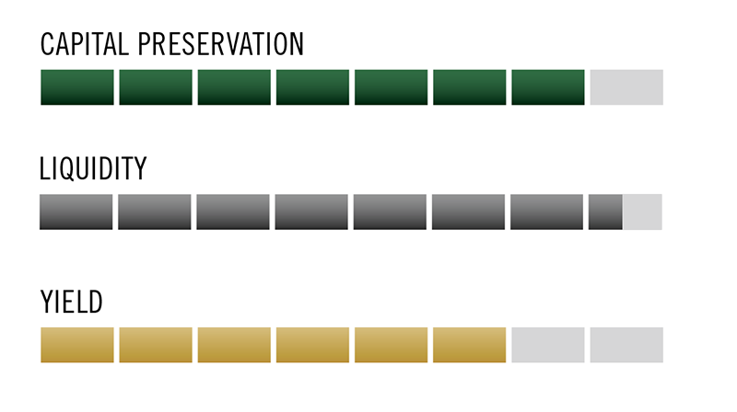
Institutional Investment Options – Investment Objectives
PRIME INSTITUTIONAL MMFs
Capital Preservation is very good based on diversification, a 40+ year MMF history and low volatility of NAV.
Liquidity (same day) is high.
Yield is high.
COMMERCIAL PAPER
Capital Preservation is good if diversified and of high credit quality.
While not designed for heavy trading, these products can be sold to provide Liquidity
Yield is moderate to high depending on maturity.
GOVERNMENT INSTITUTIONAL MMFs
Capital Preservation is excellent as securities are backed by the United States Government and/or Government Agencies and NAV is stable.
Liquidity (same day) is high.
Yield is generally low to moderate for a government-backed investment.
U.S. TREASURIES
Capital Preservation is very good as securities are direct obligations of the United States Government, but can be sensitive to interest rates.
Liquidity is high, but requires that the security be sold in the secondary market.
Yield is low to moderate depending on maturity.

Slide 5
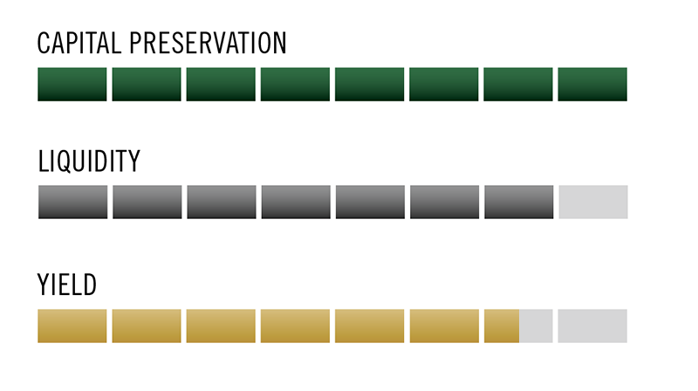
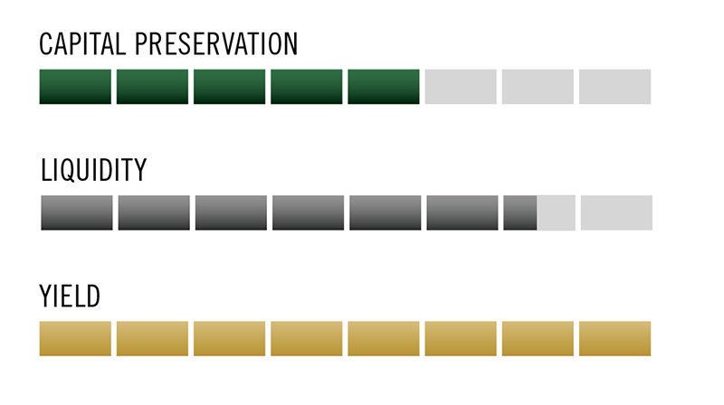
Institutional Investment Options – Investment Objectives
PRIME INSTITUTIONAL MMFs
Capital Preservation is very good based on diversification, a 40+ year MMF history and low volatility of NAV.
Liquidity (same day) is high.
Yield is high.
FEDERALLY INSURED CASH ACCOUNTS (FICA®)
Capital Preservation is excellent as deposits are backed by the United States Government.
Liquidity (next day) is high.
Yield is moderate, in general, and high for non-term, government-backed investments.
GOVERNMENT INSTITUTIONAL MMFs
Capital Preservation is excellent as securities are backed by the United States Government and/or Government Agencies and NAV is stable.
Liquidity (same day) is high.
Yield is generally low to moderate for a government-backed investment.
PRIME ULTRA SHORT BOND FUNDS
Capital Preservation is good based on diversification but can be sensitive to interest rates and credit risk.
While not designed for heavy trading, these products provide next day Liquidity.
Yield is very high.

Slide 6
Institutional Investment Options – Peer Allocations
Mean percentage distribution of cash and short-term investment holdings
INVESTMENT VEHICLE | MEAN % DIST.
Bank Deposits (DDAs, Time Deposits, CDs, ETC.) | 45%
Money Market Funds | 24%
Commercial Paper | 7%
Treasury Bills | 4%
EuroDollar Deposits (US Dollar Denominated Time Deposits at Banks Outside the US) | 4%
Separately Managed Accounts | 4%
Agency Securities | 3%
Other | 9%
Mean Number of Investment Vehicles Used | 2.7
2018 AFP Liquidity Survey
Percent of $1B+ Revenue Organization’s Short-Term Portfolios Allocated to Specific Investment Vehicles

Slide 7
Investment Workflow Efficiency

Slide 8
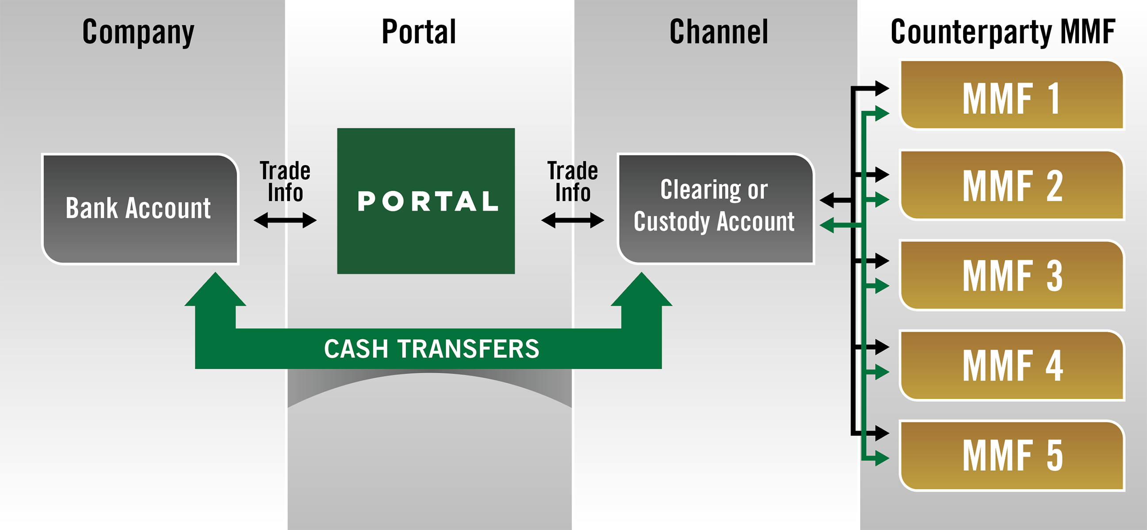
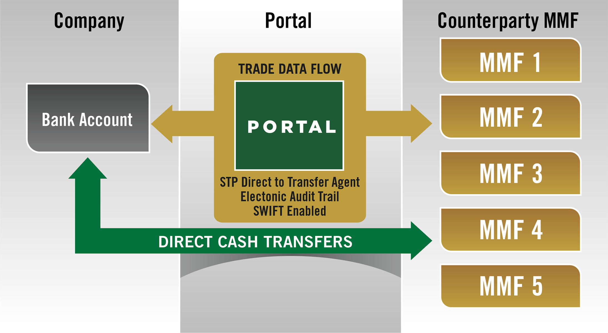
Portal Settlement Options
CLEARING/CUSTODY
DIRECT
CLEARING
ICD
CUSTODY
BNY Mellon
CitiBank
Goldman Sachs
ICD
State Street
Union Bank
Wells Fargo
DIRECT
ICD
NEX
State Street
FIS

Slide 9
Treasury Investment Scenario
TREASURY DECIDES TO DIVERSIFY EQUALLY INTO
10 MMFs
TREASURY
HAS $500 MILLION
SURPLUS CASH

Slide 10
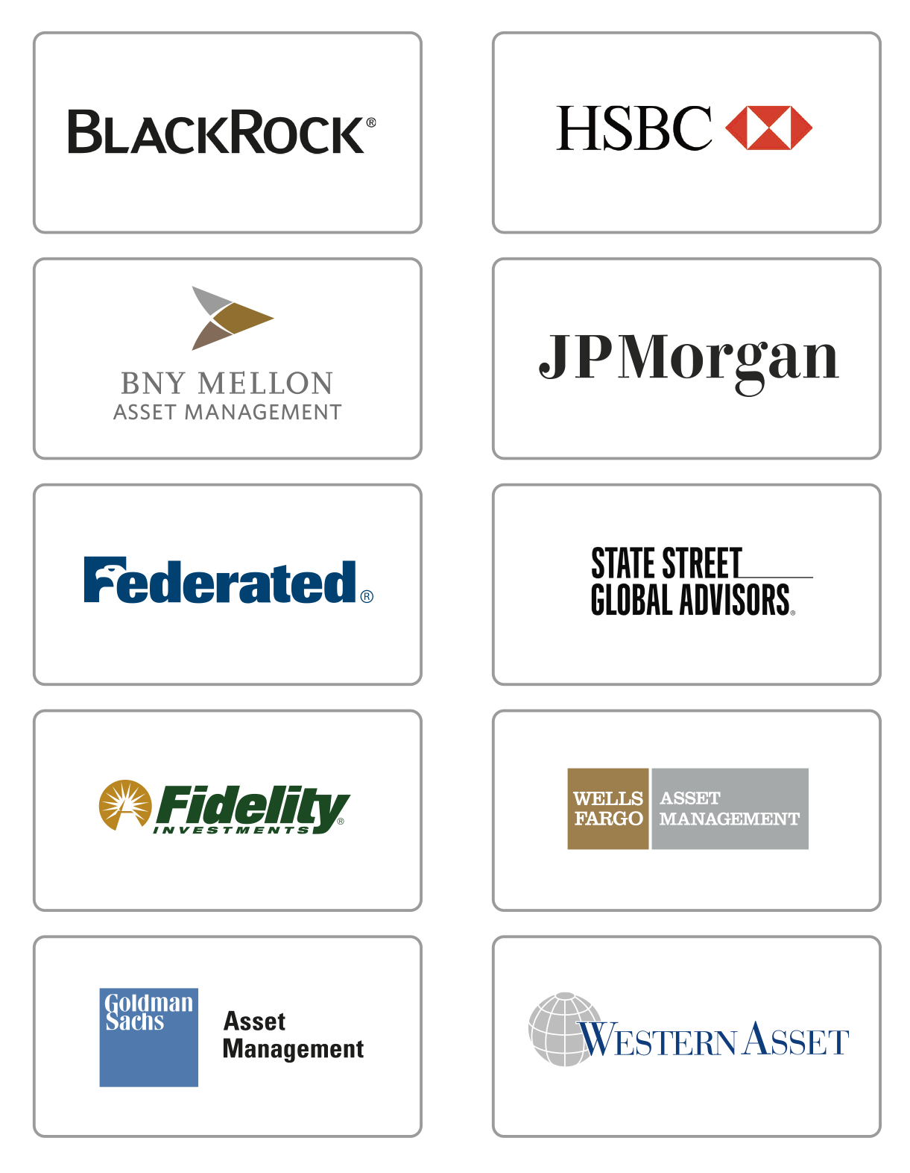
No Portal vs. Portal
NO PORTAL
PORTAL
RESEARCH
Research from 10 different websites
Research from 1 portal
APPLICATION
TRADES
HUNDREDS OF
MONEY MARKET FUNDS
DOZENS OF FUND FAMILIES
MANY ADDITIONAL SHORT TERM INVESTMENTS AVAILABLE
COMPLIANCE
SETTLEMENT
REPORTING
INTEGRATIONS
TRADE HISTORY / AUDIT REPORTS
Portals can run performance and exposure analytics hypothetical illustrations.
RISK MANAGEMENT

Slide 11
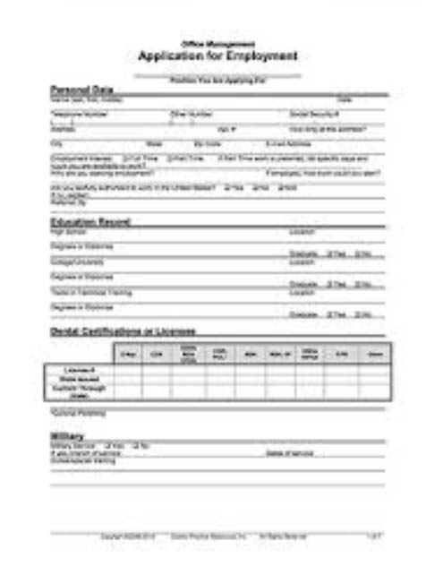
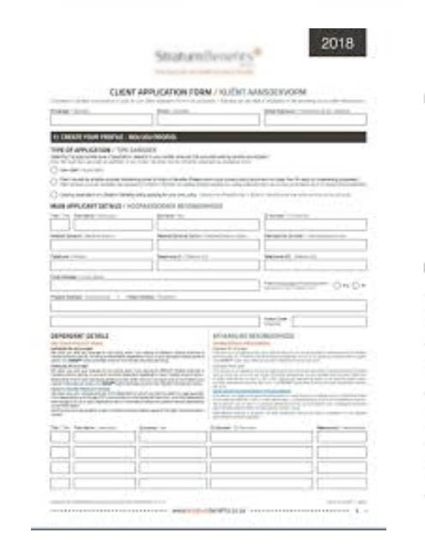
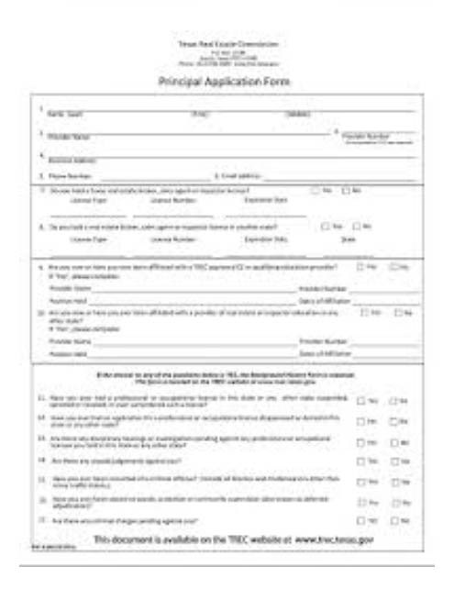
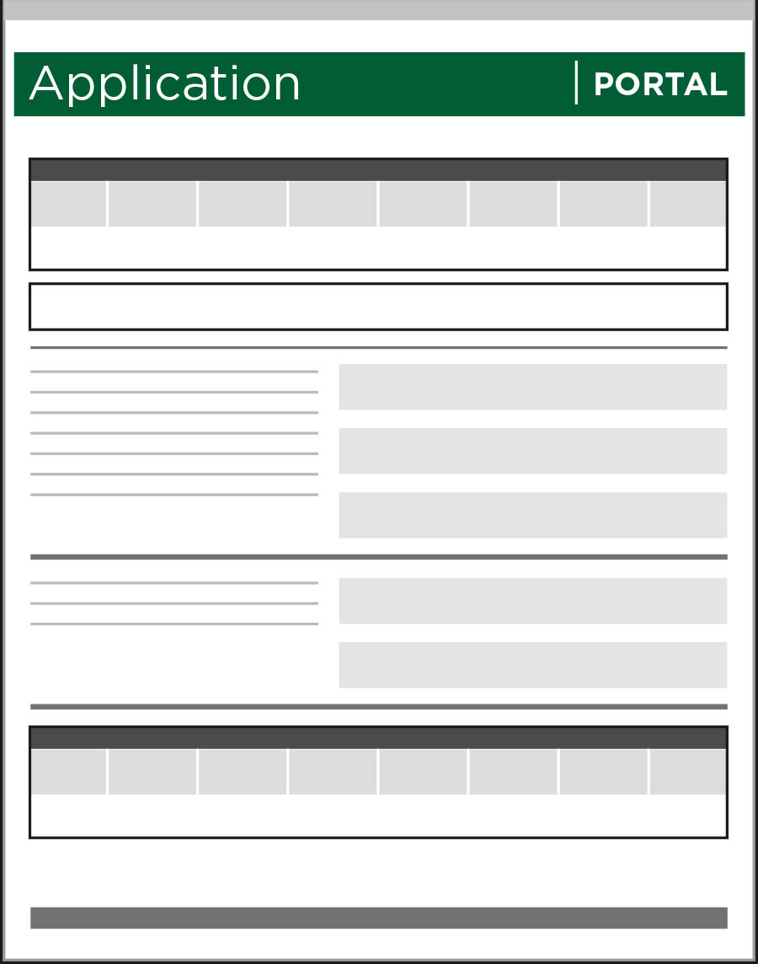
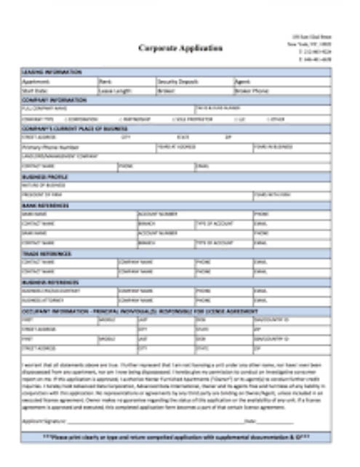
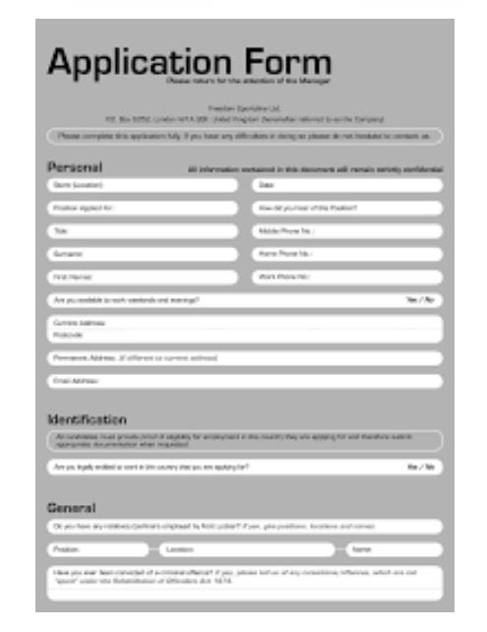
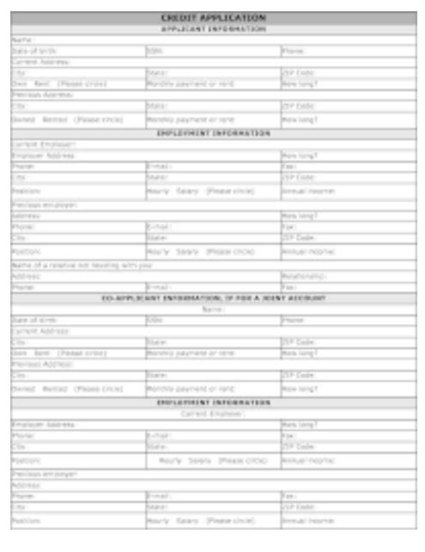
No Portal vs. Portal
NO PORTAL
PORTAL
RESEARCH
Apply with 10 non-uniform applications
1 application
APPLICATION
TRADES
COMPLIANCE
SETTLEMENT
REPORTING
INTEGRATIONS
Clearing and Custody Channels Only
TRADE HISTORY / AUDIT REPORTS
RISK MANAGEMENT

Slide 12
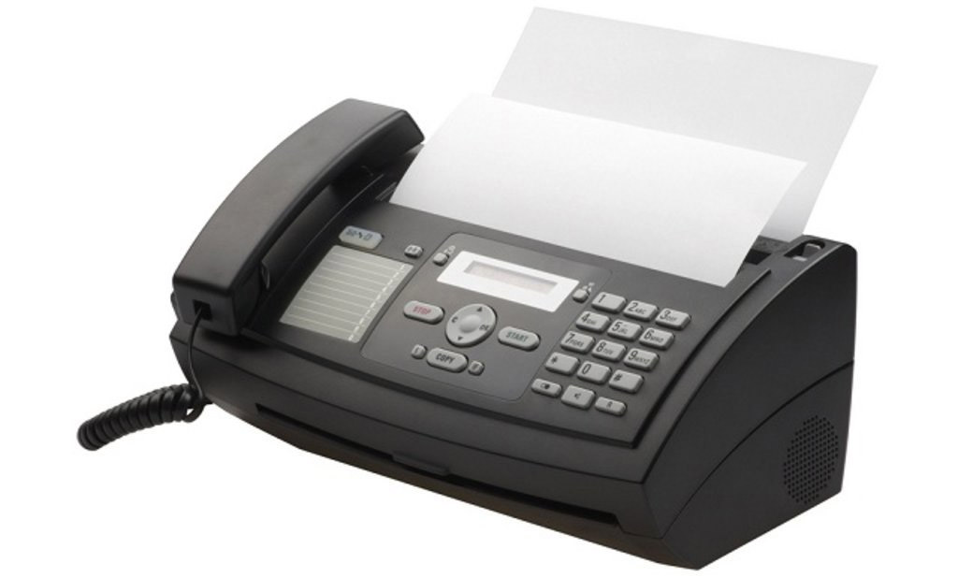
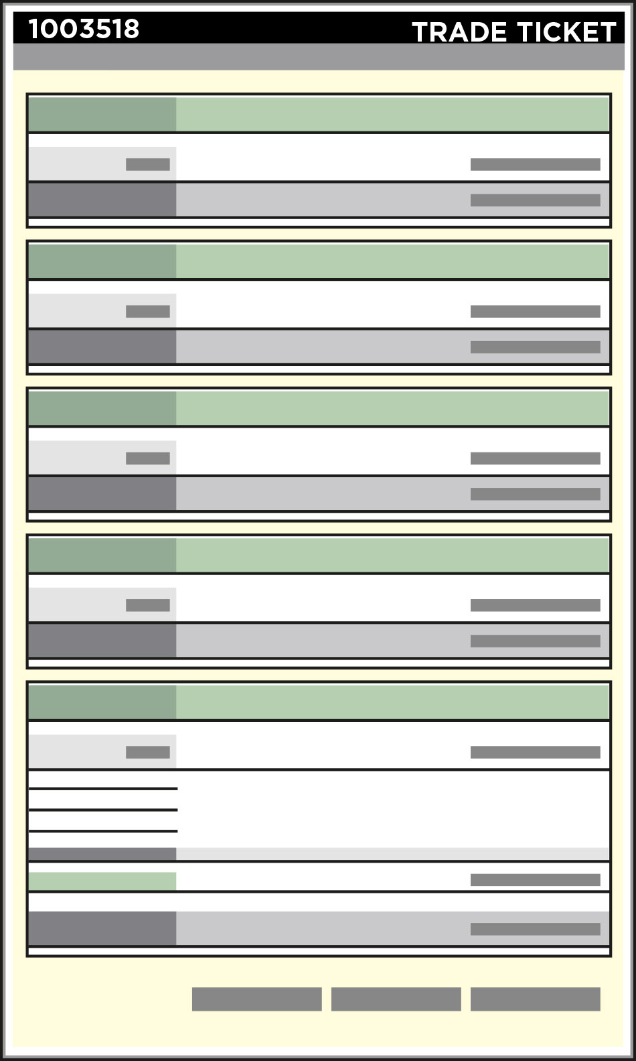
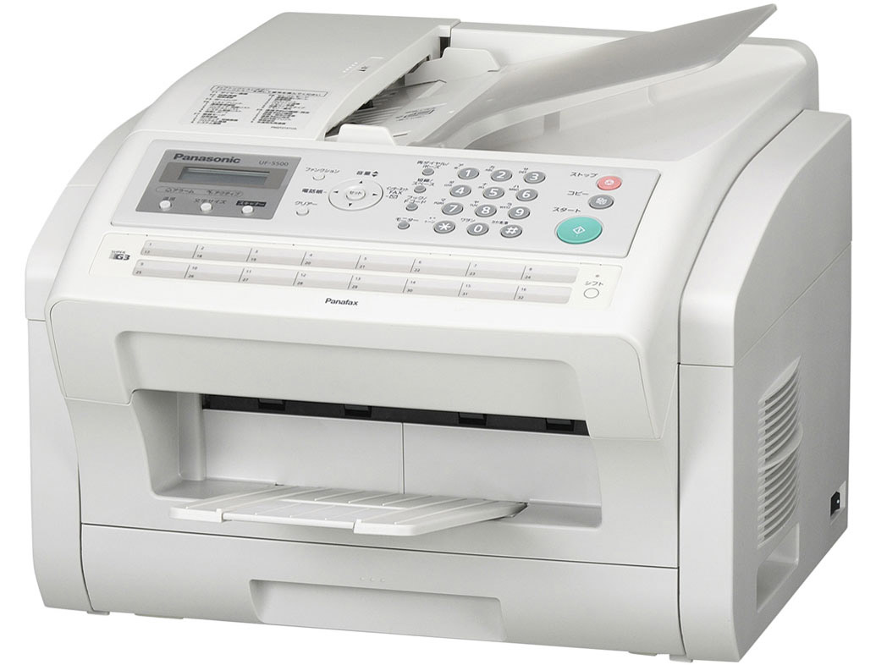
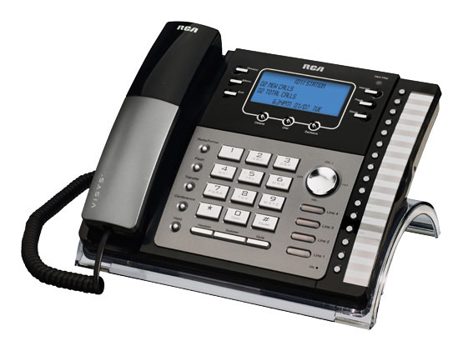
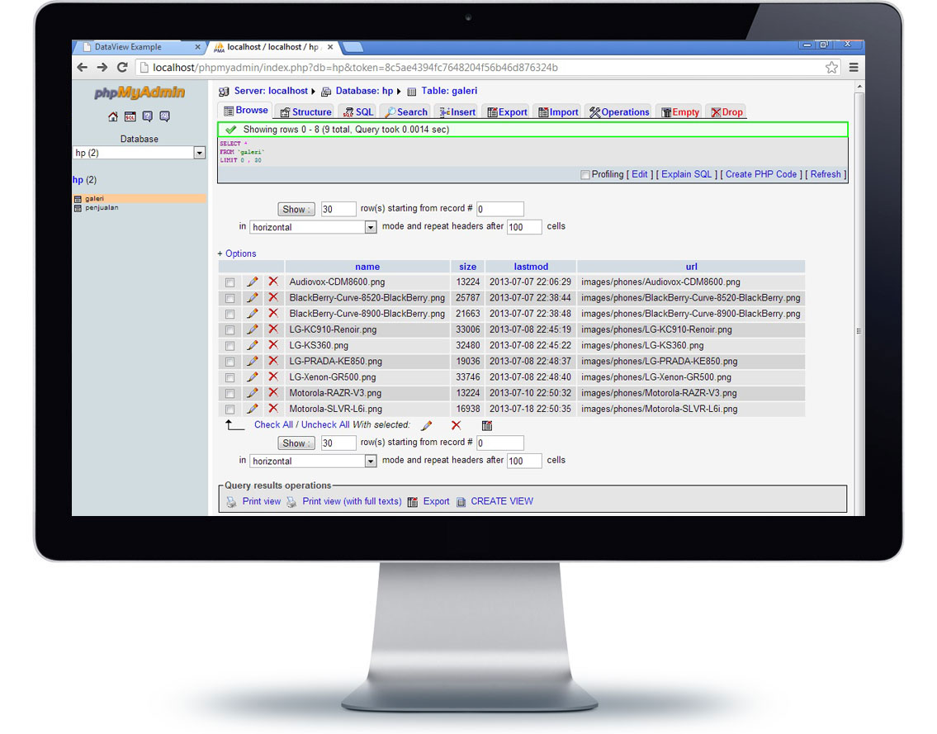
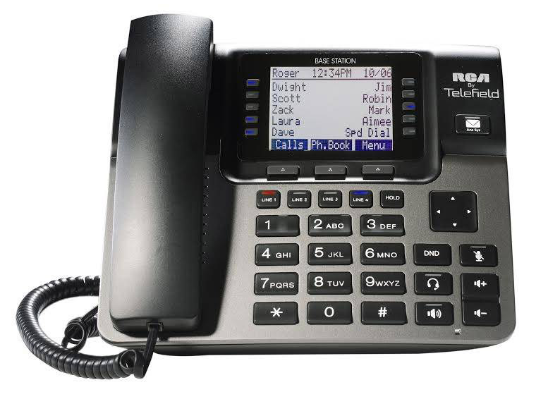
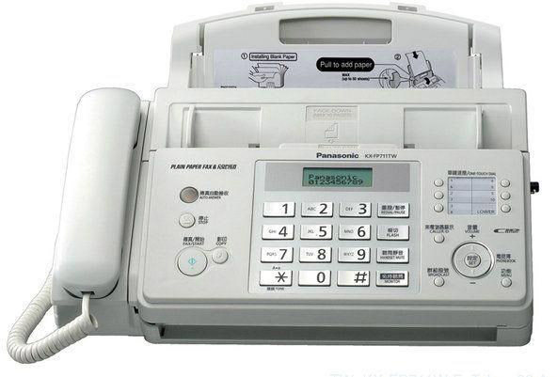
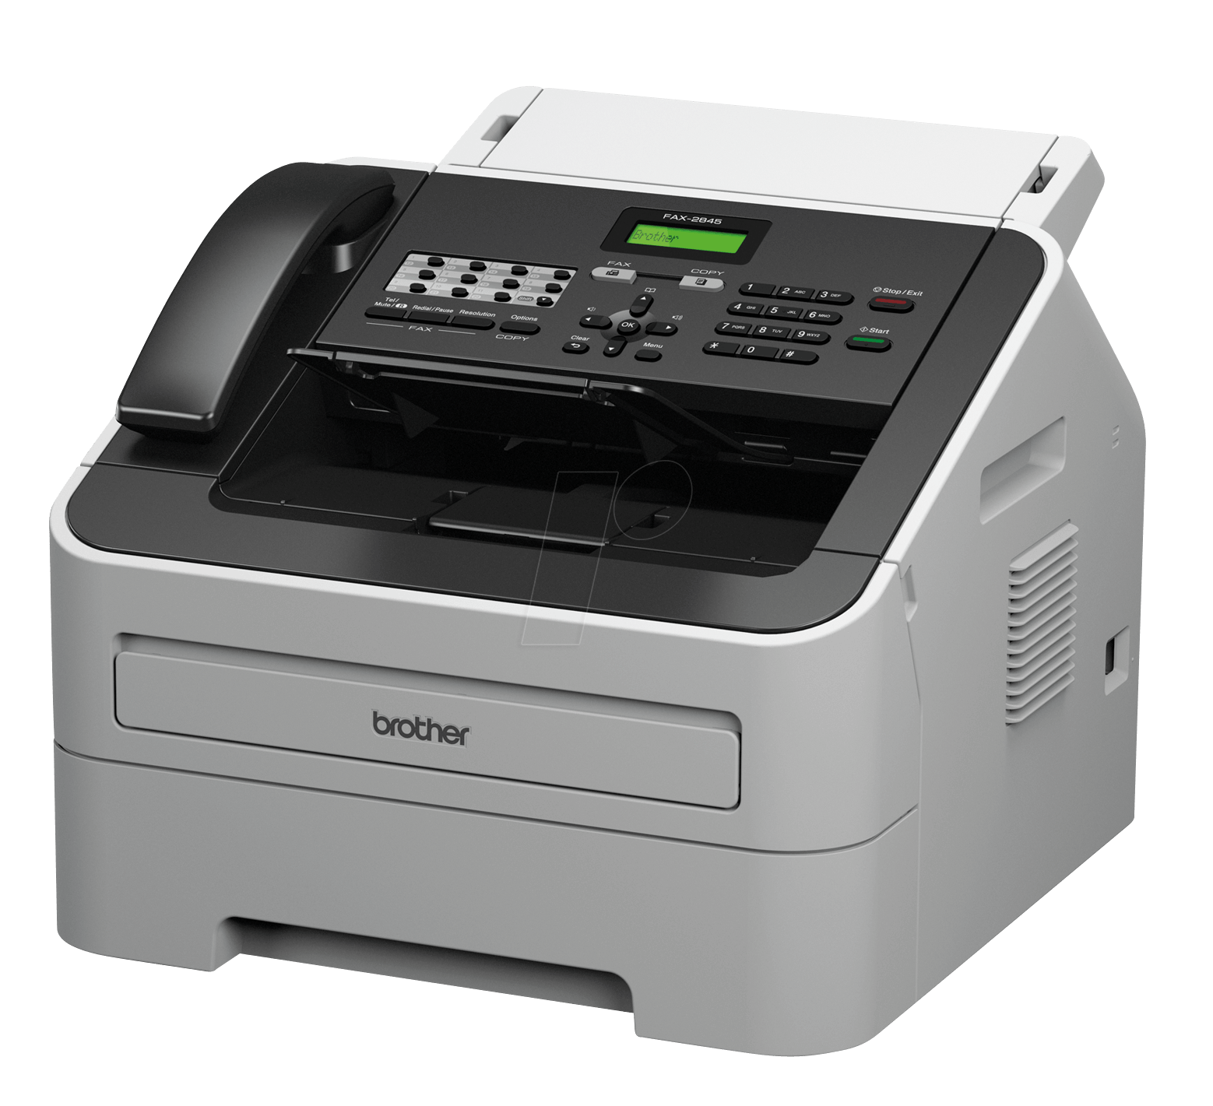
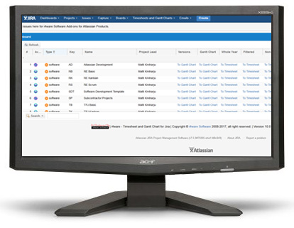
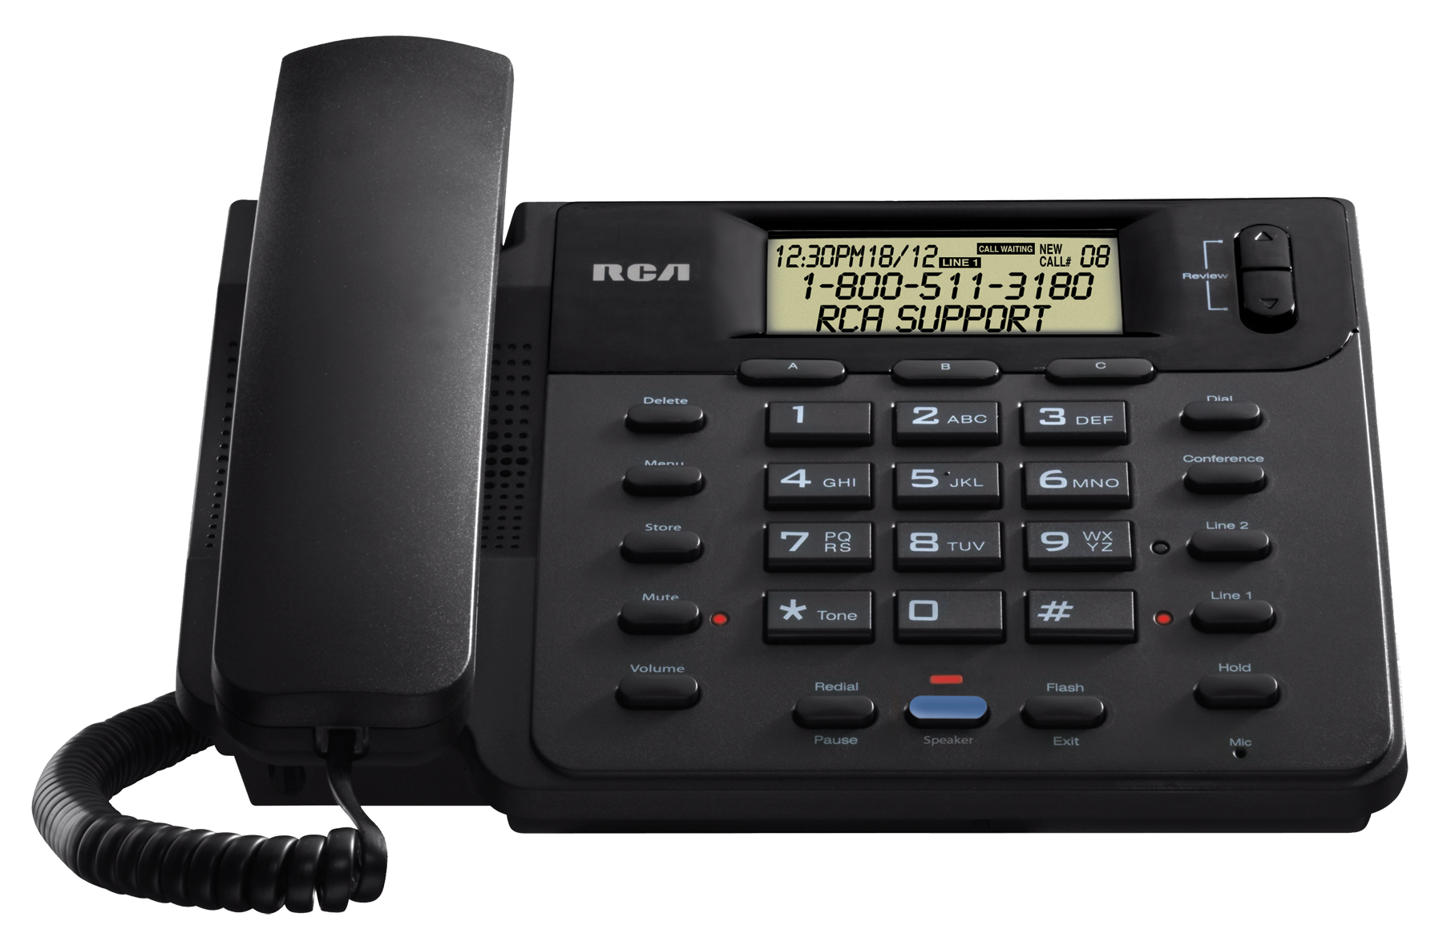
No Portal vs. Portal
NO PORTAL
PORTAL
RESEARCH
Trade by 10 separate phone calls, faxes or websites.
1 trade ticket
APPLICATION
TRADES
COMPLIANCE
SETTLEMENT
REPORTING
INTEGRATIONS
TRADE HISTORY / AUDIT REPORTS
RISK MANAGEMENT

Slide 13
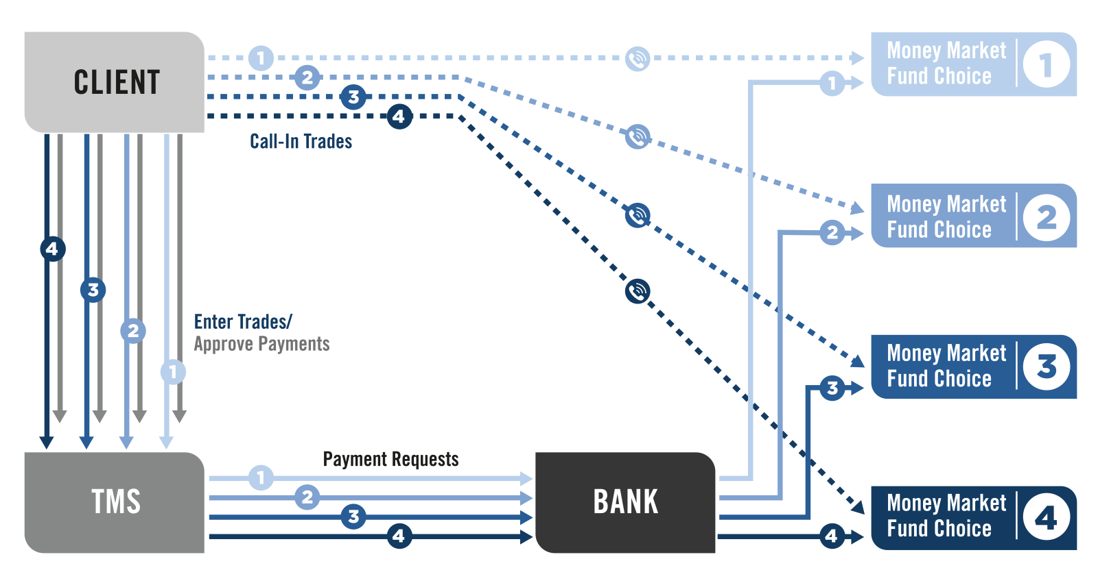
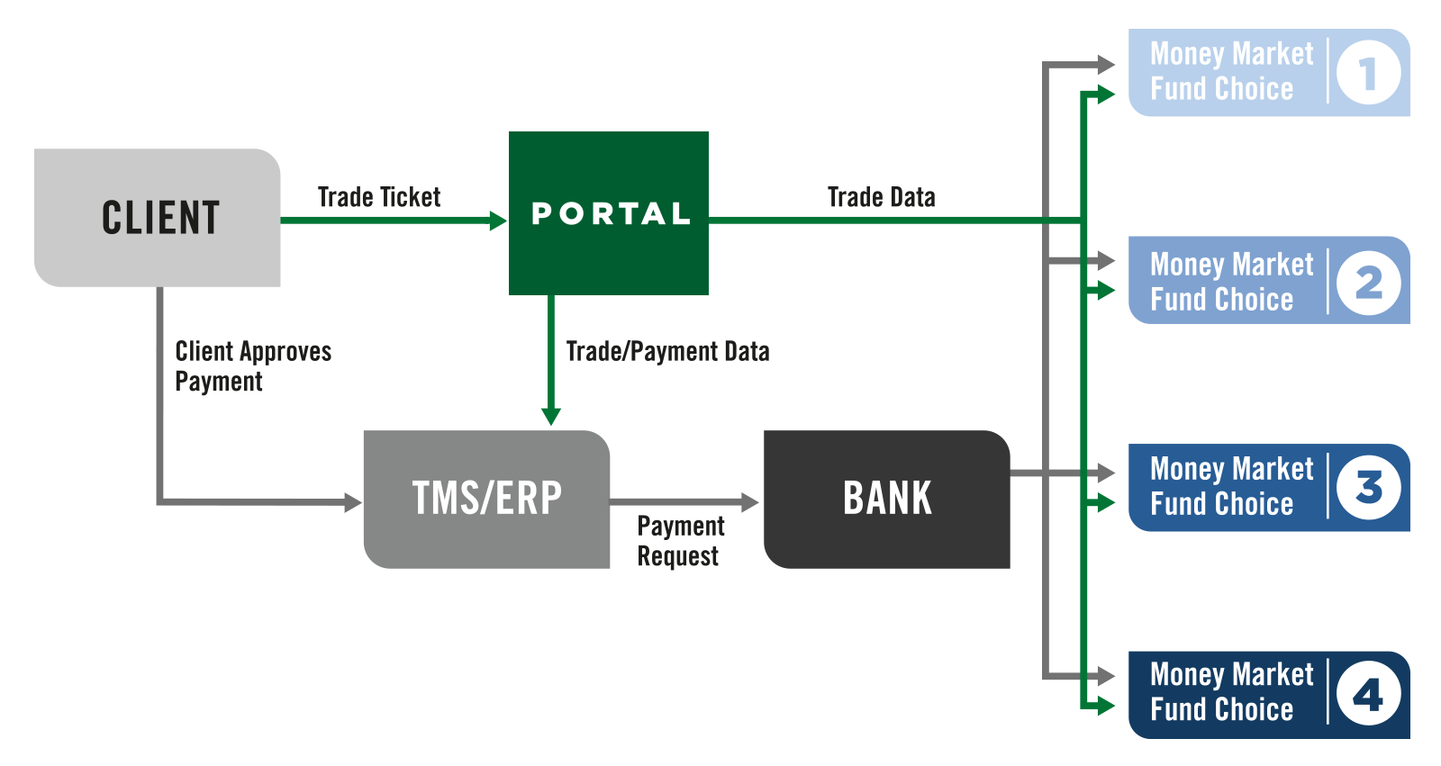
Automation Case Study – No Portal vs. Portal
No Portal
Portal

Slide 14
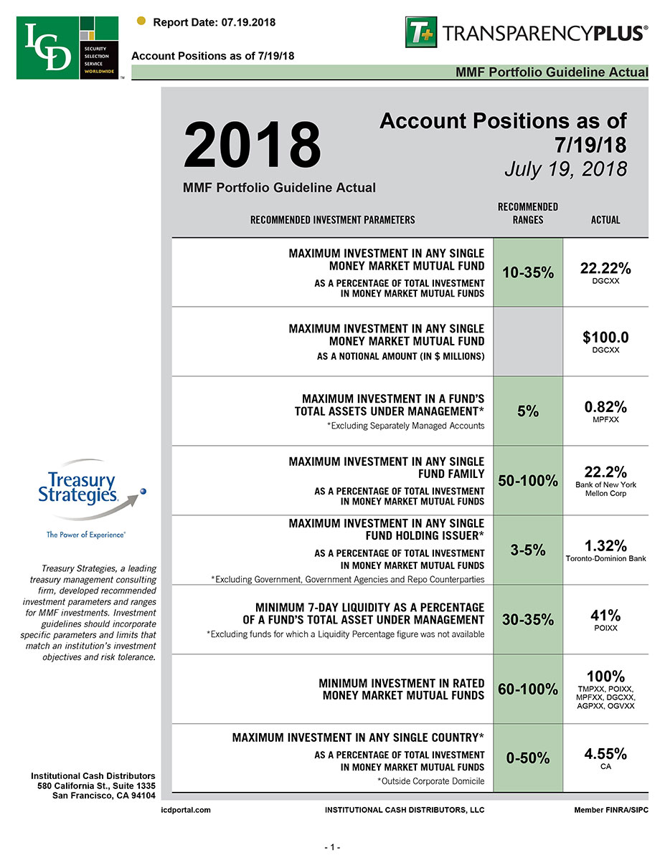
No Portal vs. Portal
NO PORTAL
PORTAL
RESEARCH
Limited or No Compliance Rules
or Compliance Monitoring
Comprehensive Compliance Rules
or Compliance Monitoring
APPLICATION
Maximum % of Assets Under Management
Maximum Notional Investment in Any Fund
Maximum Notional Investment in a Specific Fund
Minimum 7-Day Liquidity
Maximum Transaction Amount Per Currency
TRADES
COMPLIANCE
SETTLEMENT
REPORTING
INTEGRATIONS
TRADE HISTORY / AUDIT REPORTS
RISK MANAGEMENT

Slide 15
No Portal vs. Portal
NO PORTAL
PORTAL
RESEARCH
Send 10 payments to 10 counterparties
Send 1 payments to 1 counterparties
APPLICATION
TRADES
COMPLIANCE
SETTLEMENT
REPORTING
INTEGRATIONS
TRADE HISTORY / AUDIT REPORTS
RISK MANAGEMENT

Slide 16
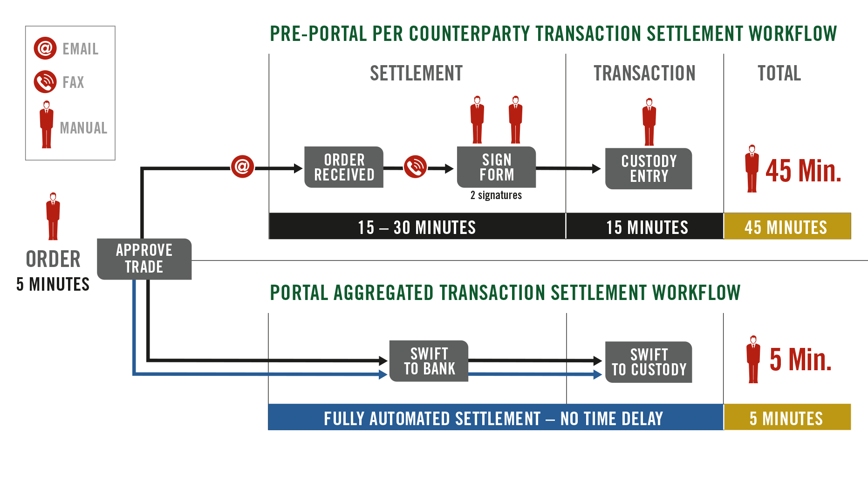
Automated Settlement Workflow
RESEARCH
APPLICATION
TRADES
COMPLIANCE
SETTLEMENT
REPORTING
INTEGRATIONS
TRADE HISTORY / AUDIT REPORTS
RISK MANAGEMENT

Slide 17
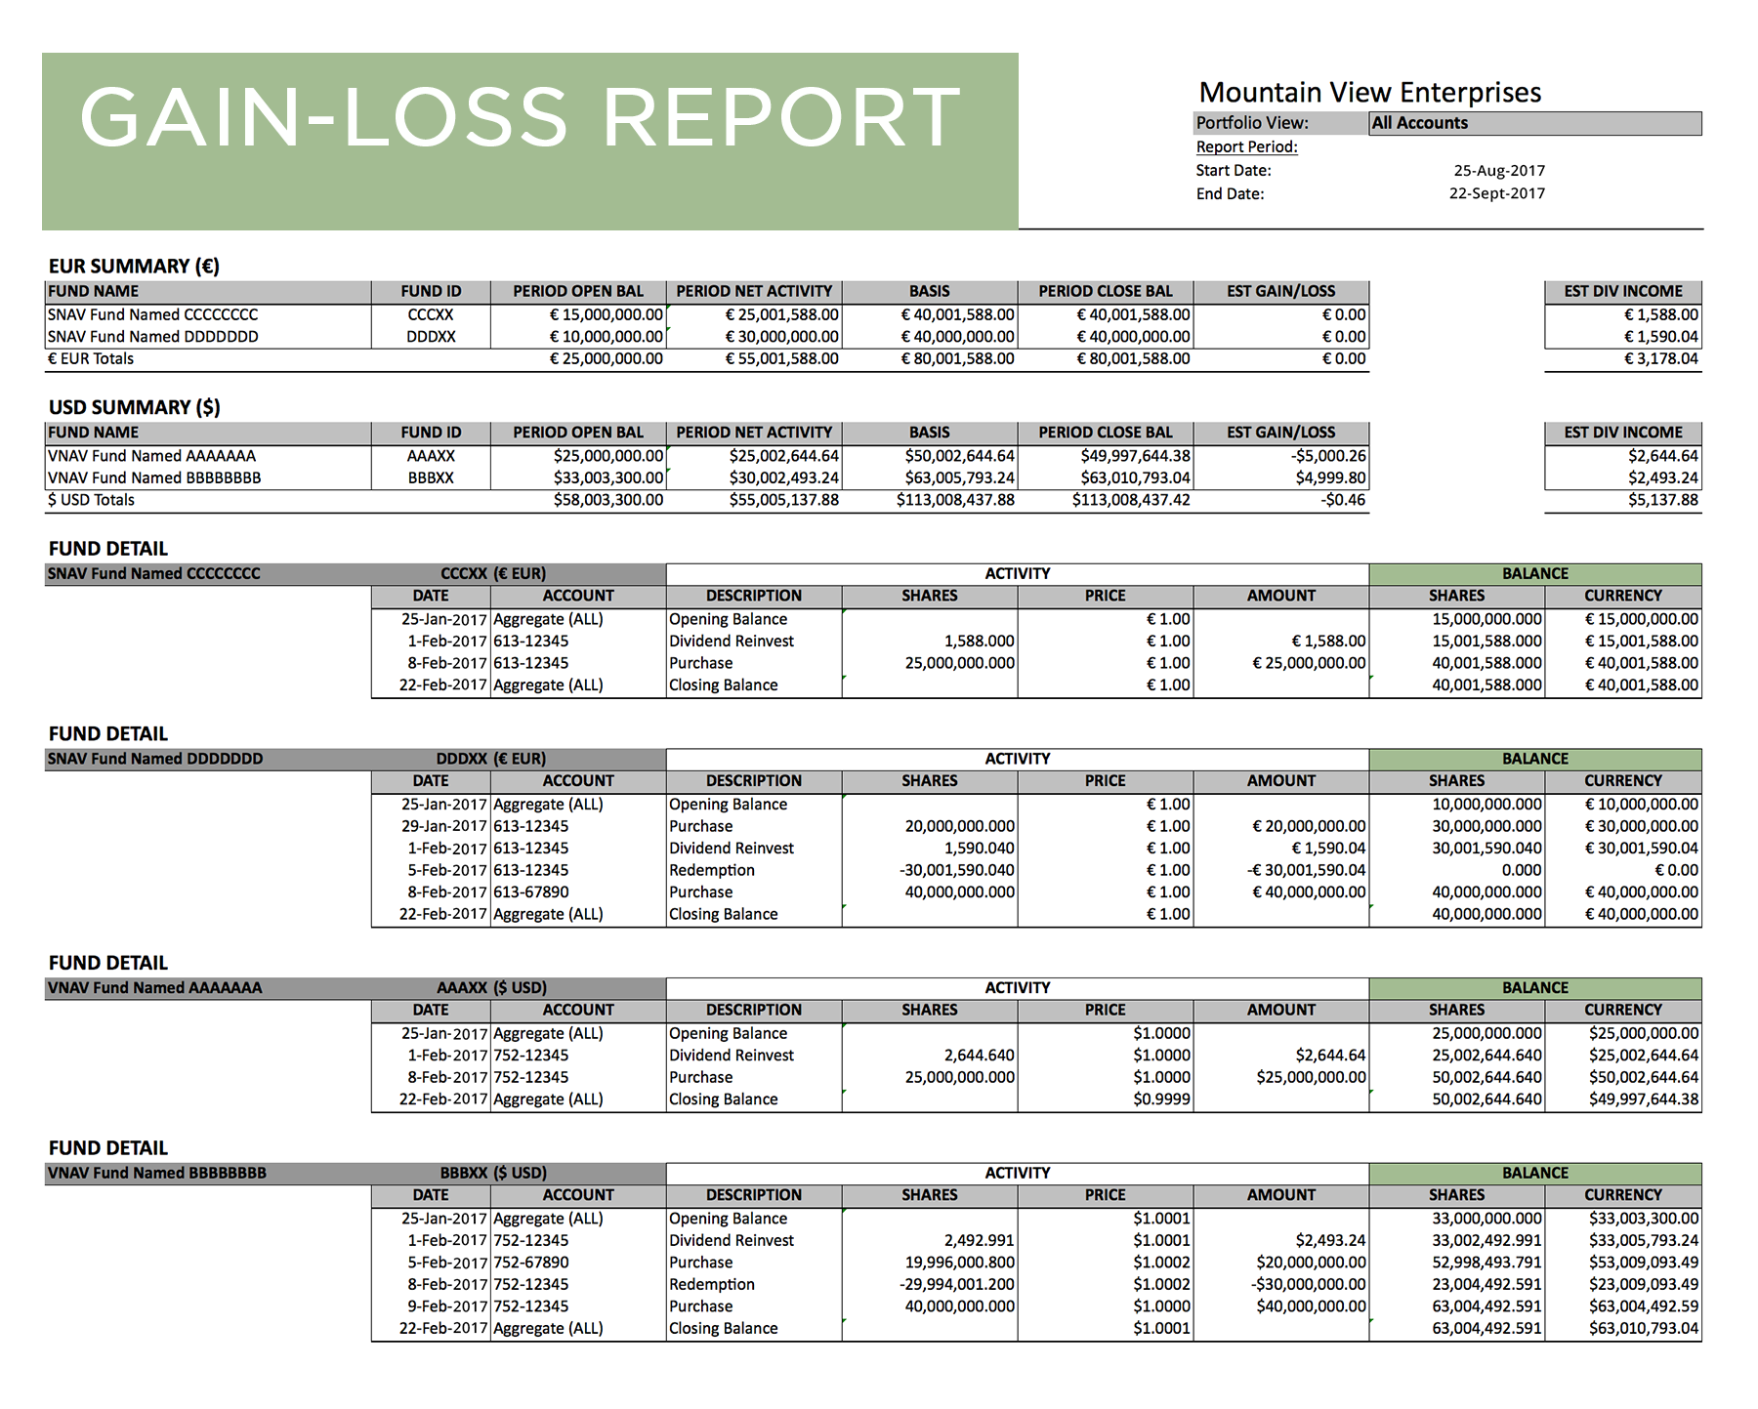
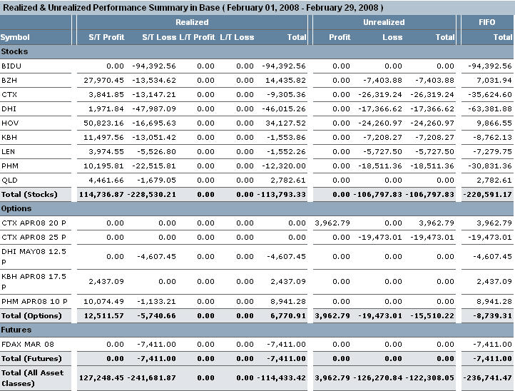
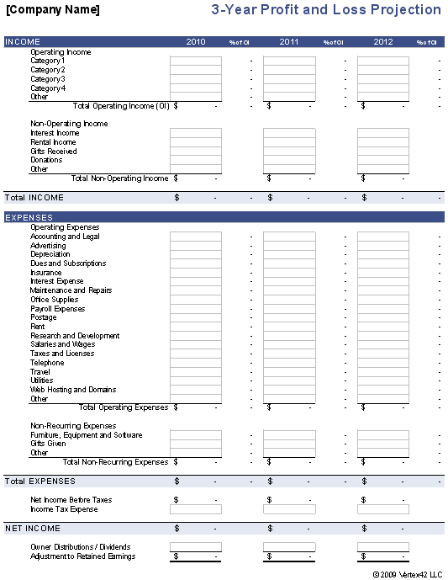
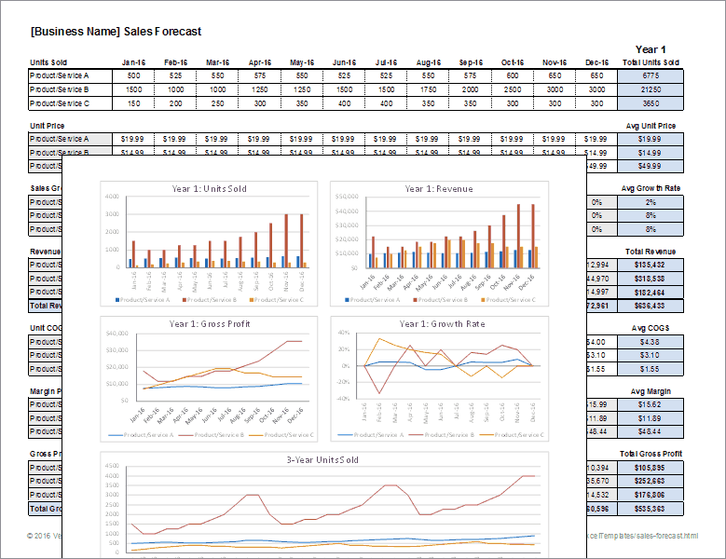
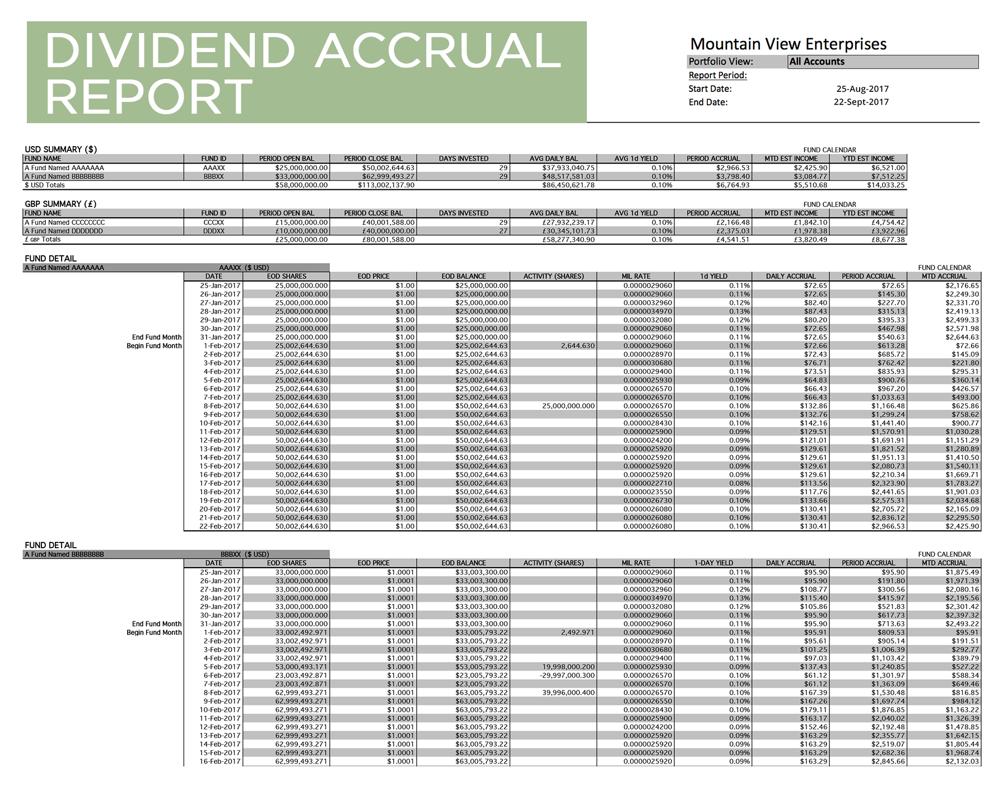
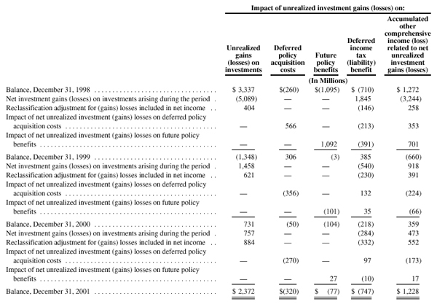
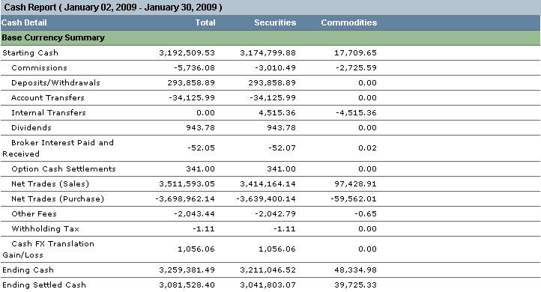
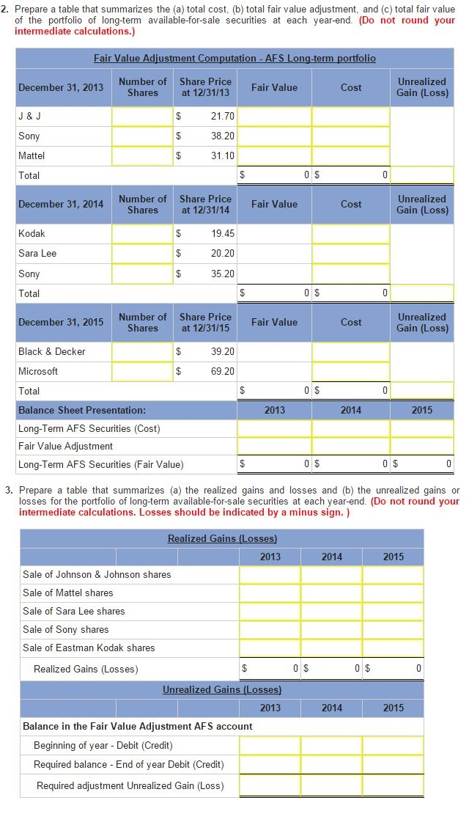
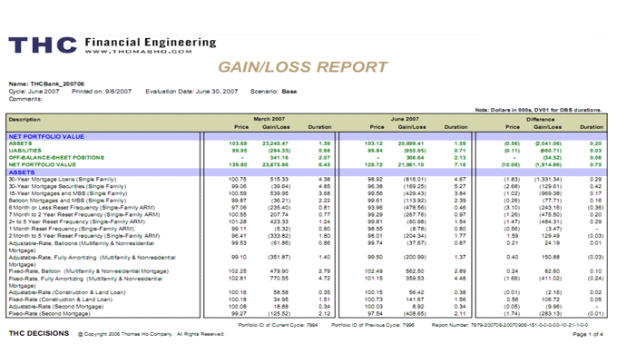
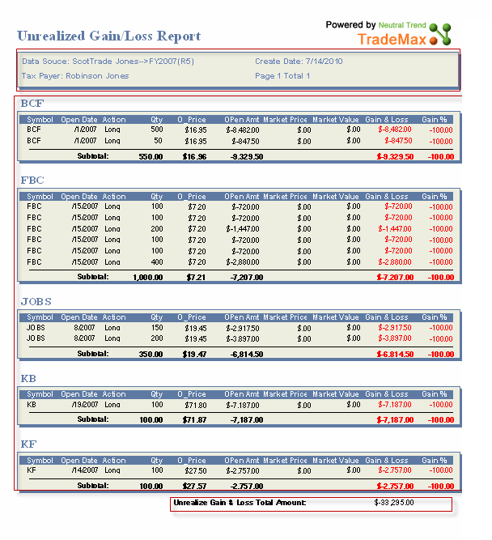
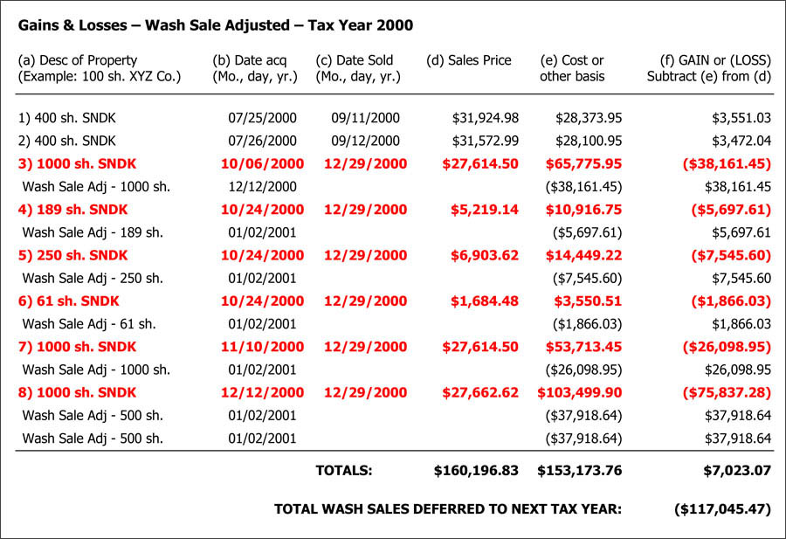
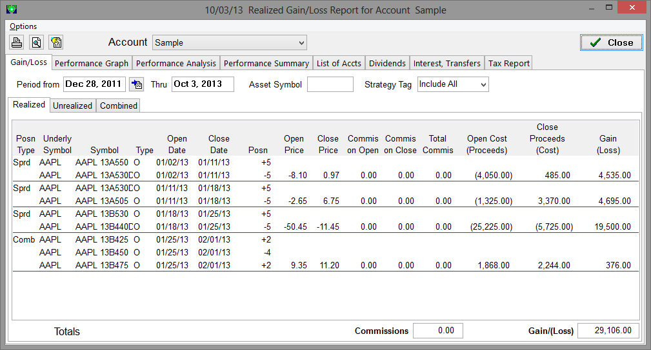
No Portal vs. Portal
NO PORTAL
PORTAL
RESEARCH
Download and/or receive10 reports
from 10 counterparties
Receive1 consolidated report
APPLICATION
TRADES
COMPLIANCE
SETTLEMENT
REPORTING
INTEGRATIONS
TRADE HISTORY / AUDIT REPORTS
RISK MANAGEMENT
Dividend Accrual and Gain-Loss Report

Slide 18
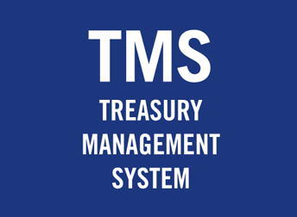
NO Portal vs. Portal
NO PORTAL
PORTAL
RESEARCH
Requires double entering 10 trades into Treasury Management System and
10 monthly dividend postings
Trade and dividend data automatically flow into Treasury Management System
APPLICATION
TRADES
TRADE
TRADE
TRADE
TRADE
TRADE
COMPLIANCE
TRADE
TRADE
TRADE
TRADE
TRADE
SETTLEMENT
REPORTING
INTEGRATIONS
TRADE HISTORY / AUDIT REPORTS
POST
POST
POST
POST
POST
RISK MANAGEMENT
POST
POST
POST
POST
POST

Slide 19
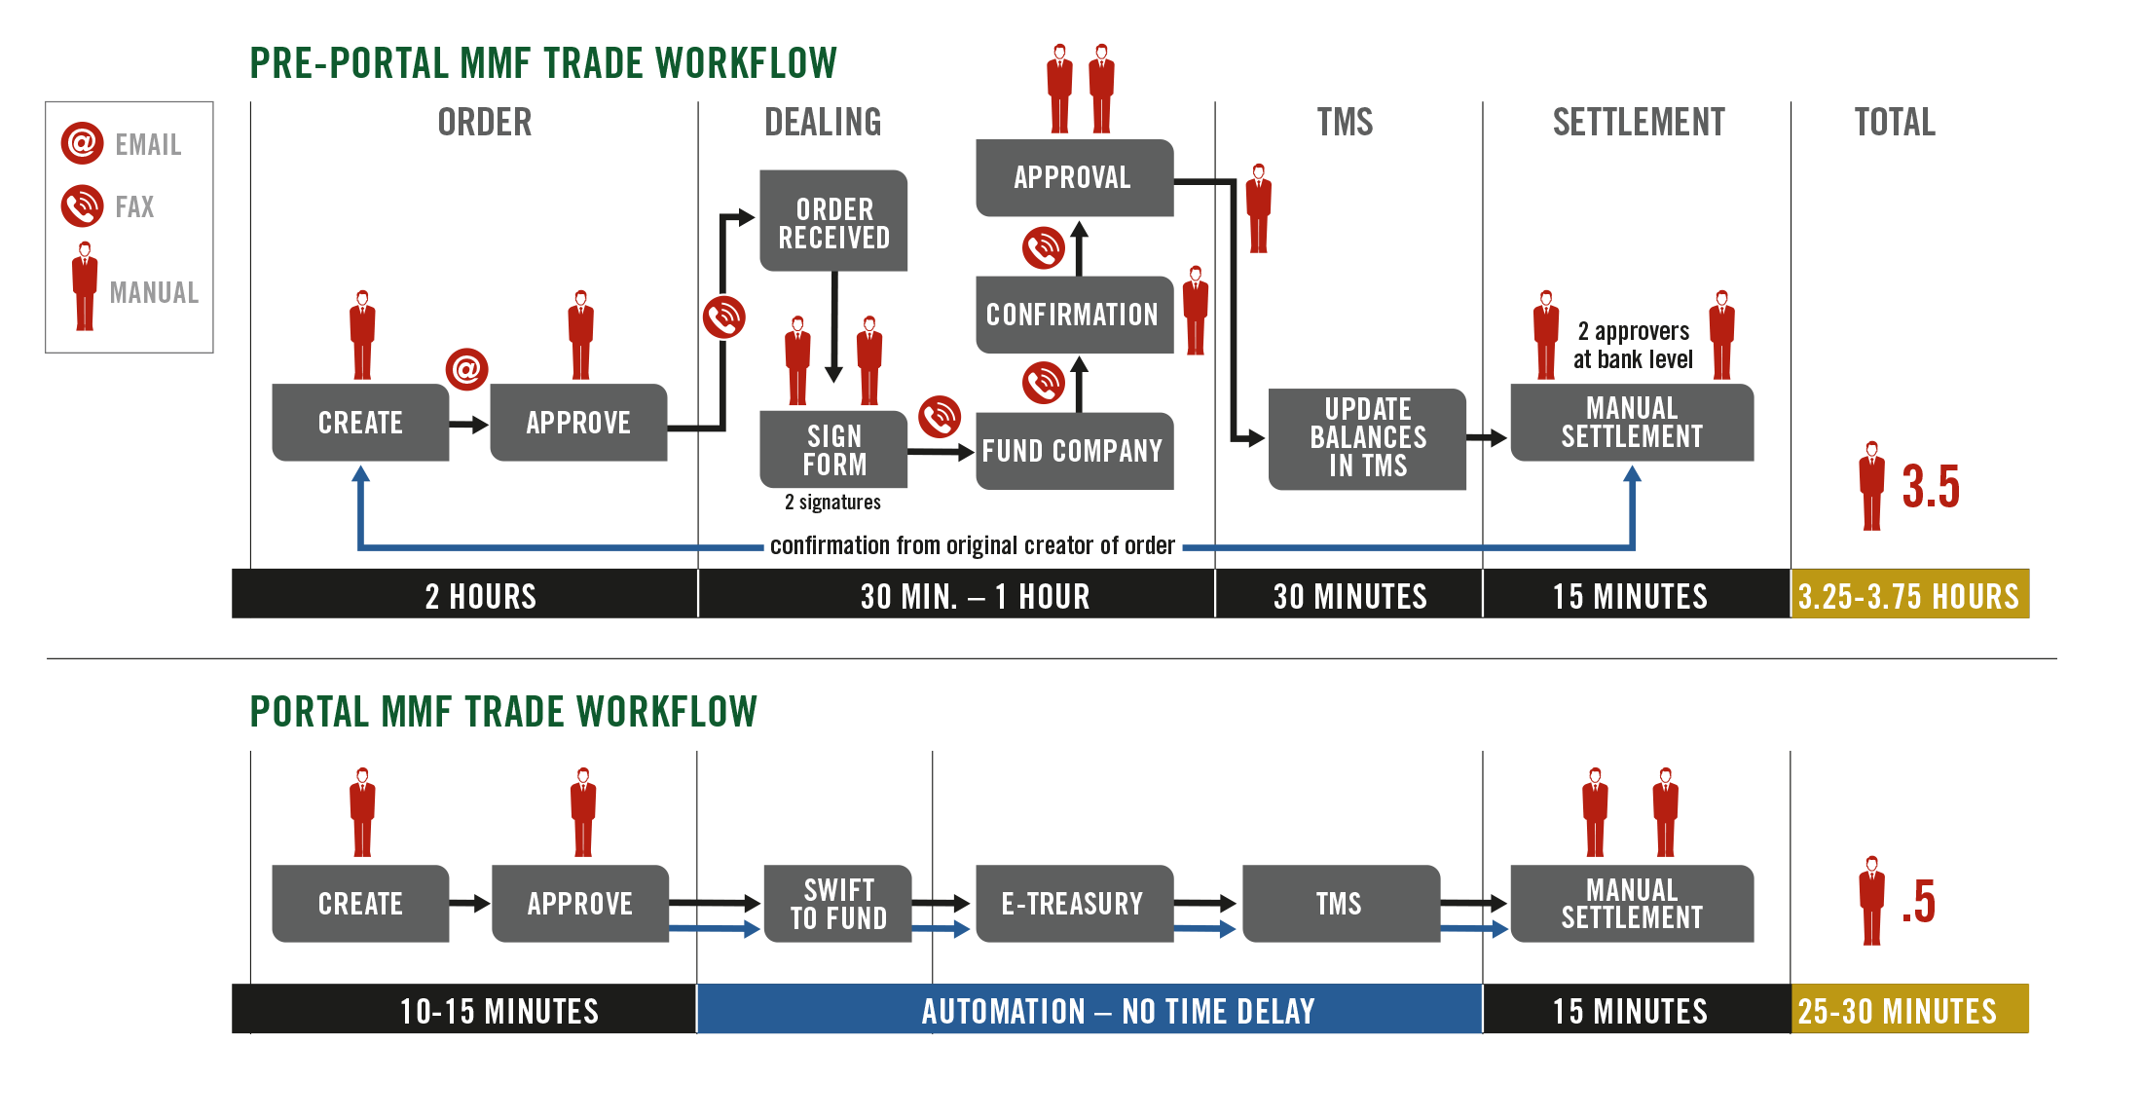
Trade Workflow – No Portal vs. Portal

Slide 20
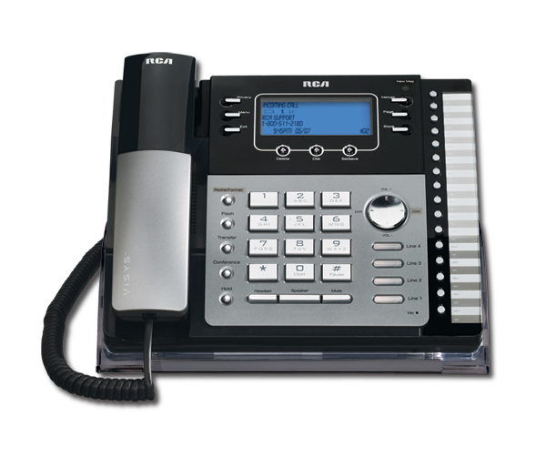
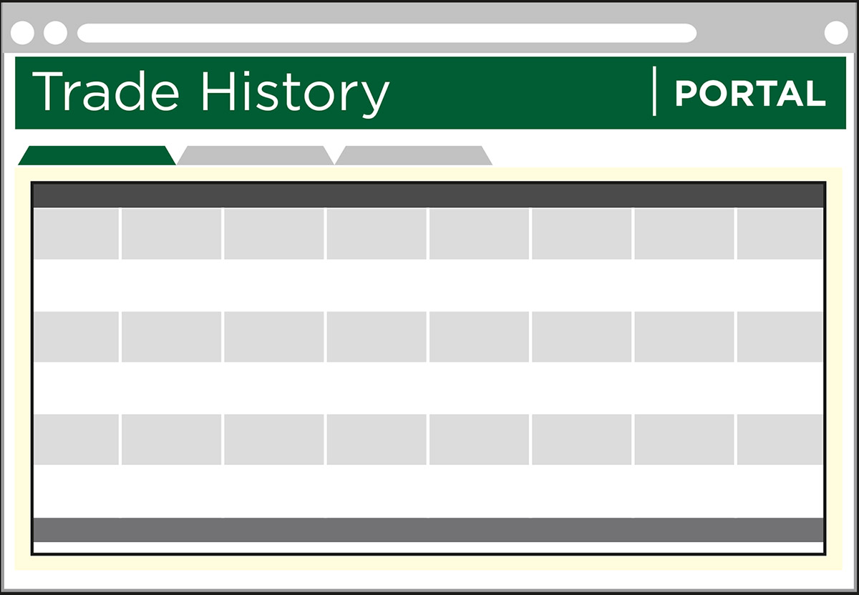
NO Portal vs. Portal
NO PORTAL
PORTAL
RESEARCH
View Trade History from10 Websites. Obtain audit reports from 10 Companies.
View all Trade History directly in 1 Portal. Obtain audit reports from 1 Company.
APPLICATION
TRADES
COMPLIANCE
SETTLEMENT
REPORTING
INTEGRATIONS
TRADE HISTORY / AUDIT REPORTS
RISK MANAGEMENT

Slide 21
No Portal vs. Portal
NO PORTAL
PORTAL
Obtain, normalize, aggregate holdings reports from 10 separate providers
Click 1 button for access to 8 exposure analytics reports
RESEARCH
APPLICATION
TRADES
COMPLIANCE
SETTLEMENT
REPORTING
INTEGRATIONS
TRADE HISTORY / AUDIT REPORTS
RISK MANAGEMENT
COMPANY EXCEL DATABASE

Slide 22
Exposure Analytics Workflow – No Portal vs. Portal

Slide 23
Counterparty Exposure
RESEARCH
APPLICATION
TRADES
COMPLIANCE
SETTLEMENT
REPORTING
INTEGRATIONS
TRADE HISTORY / AUDIT REPORTS
RISK MANAGEMENT

Slide 24
Counterparty Exposure
RESEARCH
2008 Stock Pricing
APPLICATION
LEHMAN
WELLS FARGO
BNP PARIBAS
TRADES
01/31/08 64.05 34.01 63.98
COMPLIANCE
02/29/08 50.99 29.23 57.90
03/31/08 37.64 29.10 62.09
04/30/08 44.24 29.75 67.30
05/30/08 36.81 27.57 64.48
06/30/08 19.81 23.75 55.92
07/31/08 17.34 30.27 62.01
SETTLEMENT
REPORTING
INTEGRATIONS
TRADE HISTORY / AUDIT REPORTS
-73% -11% -3%
RISK MANAGEMENT
Notes:
Let me show you an example why. Exposure Analytics with Leading Indicator Metrics can be extremely valuable
If you were invested in the Reserve Primary Fund back in 08 and were running exposure analytics
You would have reviewed the counterparties in your portfolio, and would have seen you were invested in Lehman Brothers.
In comparing leading indicator metrics of Lehman Brothers and its peers, you would have seen Lehman Brothers’ stock price was cratering while other financial companies like Wells and BNP remained stable.
Let’s say you had a well diversified portfolio made up of 10 different prime MMFs. Chances are that the Reserve Primary Fund was the only fund in your portfolio that had Lehman exposure.
At that point, being a risk-averse investor you would have gotten out of the fund well in advance of the problems the Reserve Primary Fund faced in the fall.

Slide 25
Counterparty Exposure
Reserve Primary Fund 10/2007 Fund Report (Hypothetical)
RESEARCH
APPLICATION
TRADES
COMPLIANCE
3%
ABCP
15%
ABCP
40%
ABCP
SETTLEMENT
REPORTING
INTEGRATIONS
TRADE HISTORY / AUDIT REPORTS
RISK MANAGEMENT
Notes:
You may have gotten out of the Reserve Primary Fund well before that if Transparency Plus was available and you were viewing its fund reports
ABCP is one of the riskier investments in MMF portfolios
The Reserve Primary Fund went from 3% ABCP in Oct 2006 to 40% ABCP in OCT 2007
And 15% to 40% in just one month.
At that point, you would have seen the Reserve Primary Fund dramatically moved to a far riskier investment strategy and you would have headed for the exit.
These examples show why it is critical for corporate treasury to run analytics with leading indicator metrics to minimize risk.
This may seem a little overwhelming if you have no exposure analytics experience. It’s not, and we can show you how.

Slide 26
EU Reform Timeline
The new regulations mainly focus on fund structure, composition, valuation, liquidity requirements, liquidity fees/redemption gates, understanding investor behavior and information reporting.
Money Market Funds will be categorized into two types of money market funds: Short Term Money Market Funds and Standard Money Market Funds:
FUND OPTIONS | Short Term MMF | Standard MMF
Public Sector Constant Net Asset Value (CNAV) | X
Low Volatility Net Asset Value (LNAV) – NEW | X
Variable Net Asset Value (VNAV) | X | X

Slide 27
Portal Advantages

Slide 28
No Portal vs. Portal - Cost
NO PORTAL
PORTAL
$0
$0

Slide 29
Investment Workflow Efficiency & Investment Alternatives

